Slide 1

BEYOND GDP: ECONOMICS AND HAPPINESS -NIKITA VOHRA

Slide 2
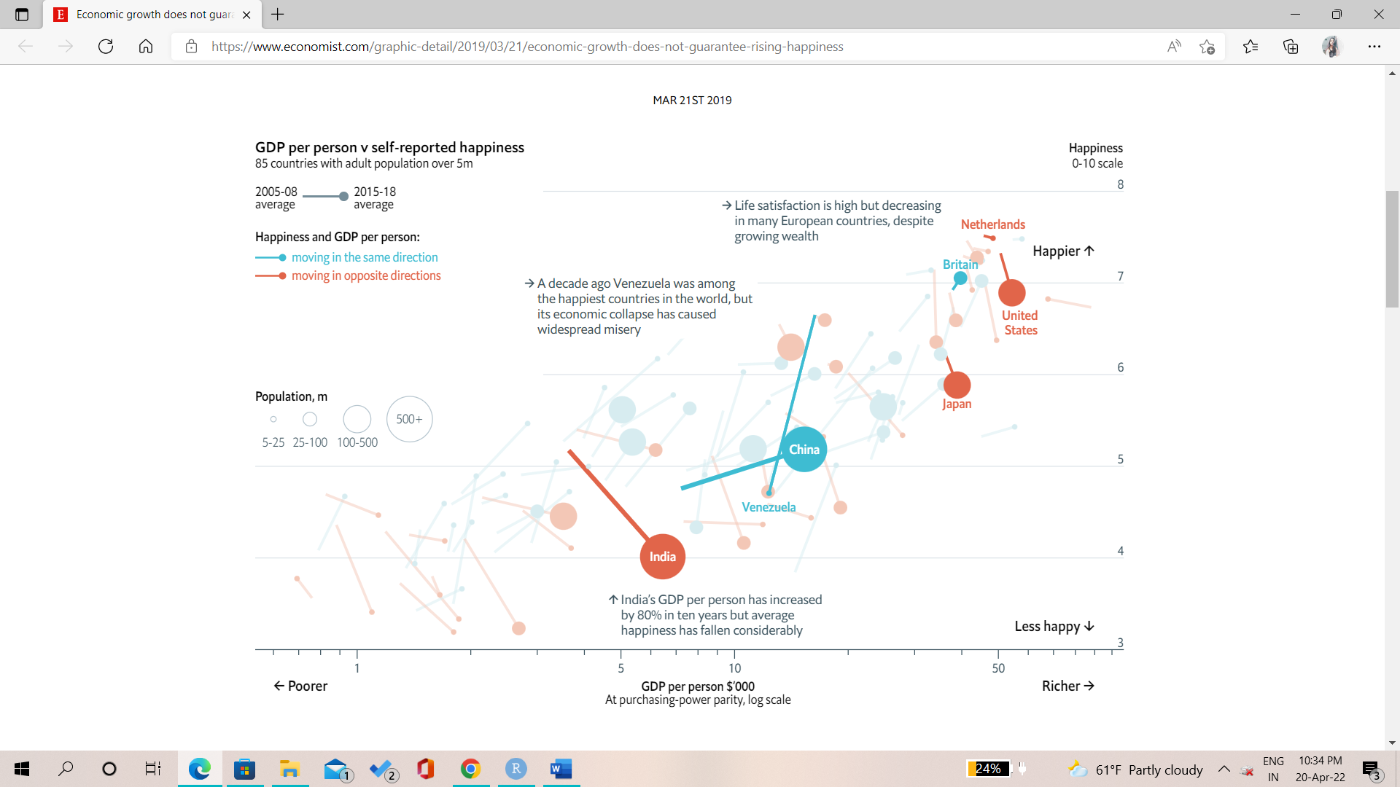
INTRODUCTION
Everyone wants to achieve happiness as an end goal
To understand what it takes to be happy and include it in our developmental policies we have to make it quantifiable
Over the years, research studies have found out that even when the GDP of a country increases, it doesn’t necessarily mean the country is happy.
Other factors that might influence happiness are- Social support, Healthy life, Freedom to make independent choices, Generosity, and Perception of corruption

Slide 3
RESEARCH METHODOLOGY
We take the following variables from a report of the UN on the World’s happiness index and perform correlation and regression analysis to understand how much each variable impacts a country’s happiness using visualization and statistical techniques.
DATA CLEANING:
No missing values and outliers for any variables.
Asymmetric distribution in data except for Happiness Score which is normally distributed.
 | Rank | GDP | Social Support | Healthy | Freedom | Generosity | Corruption
Min | 1 | 0 | 0 | 0 | 0 | 0 | 0
1st Quantile | 37.25 | 1096 | 732 | 463.2 | 440.5 | 89 | 68.25
Median | 73.5 | 1446 | 957.5 | 621.5 | 543.5 | 132.5 | 119.5
Mean | 73.5 | 1410 | 905.9 | 586.2 | 517.2 | 147.4 | 154.78
3rd Quantile | 109.75 | 1785 | 1114.2 | 719.8 | 626 | 197.8 | 198.5
Max | 146 | 2209 | 1320 | 942 | 740 | 468 | 587

Slide 4
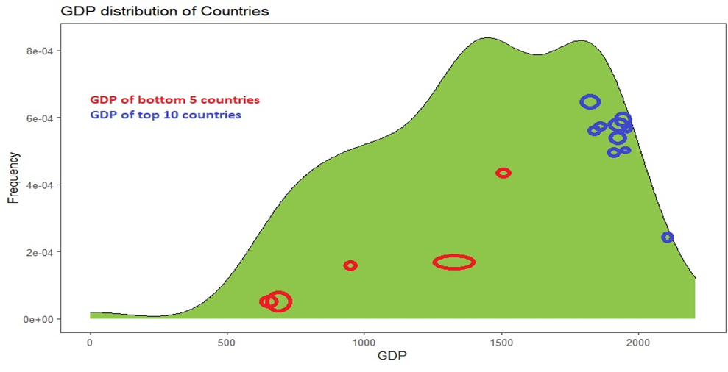
ANALYSIS AND RESULTS TOP 10 AND BOTTOM 5 COUNTRIES ACCORDING TO THE HAPPINESS SCORES AND HOW THEIR GDP VARIES
Top 10 | Country | Happiness_Score |  | Bottom 5 | Country | Happiness_Score
 | <fct> | <dbl> |  |  | <fct> | <dbl>
1 | Denmark | 7636 |  | 1 | Afghanistan | 2404
2 | Finland | 7821 |  | 2 | Botswana* | 3471
3 | Iceland | 7557 |  | 3 | Lebanon | 2955
4 | Israel | 7364 |  | 4 | Rwanda* | 3268
5 | Luxembourg | 7404 |  | 5 | Zimbabwe | 2995
6 | Netherlands | 7415
7 | New Zealand | 7200
8 | Norway | 7365
9 | Sweden | 7384
10 | Switzerland | 7512
GDP of the happy countries mostly ranges from 1800-2100, while the unhappy countries have a shallow GDP range from 700 and to a maximum of 1500
GDP also plays a vital role in an individual’s happiness and hence the country’s happiness index

Slide 5
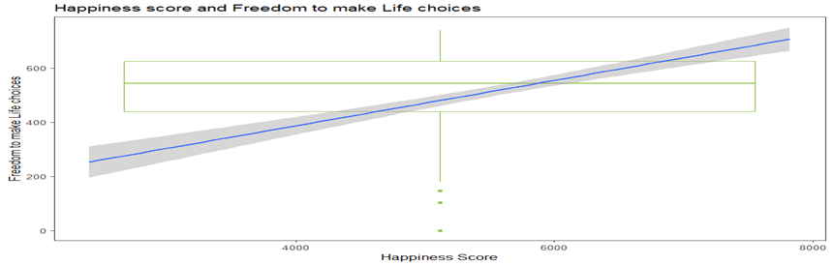
OTHER FACTORS AND HAPPINESS FREEDOM TO MAKE LIFE CHOICES The graph below indicates a strong positive correlation between Freedom to make life choices and the happiness of an individual as the slope of the curve is upward sloping The correlation coefficient is 0.62 depicting a significant relationship

Slide 6
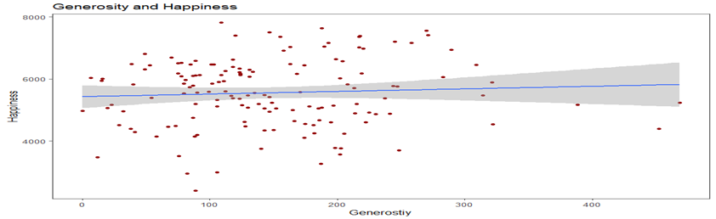
GENEROSITY Generosity doesn’t seem very significant when compared to the happiness index It is almost a straight line when plotted on a graph The correlation coefficient also equals 0.063 which is not significant at all

Slide 7
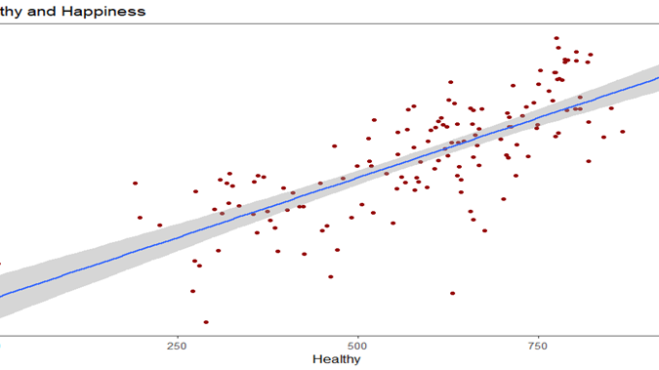
Healthy life
Health seems to have a significant impact on happiness of people
Correlation coefficient also equlas 0.74

Slide 8
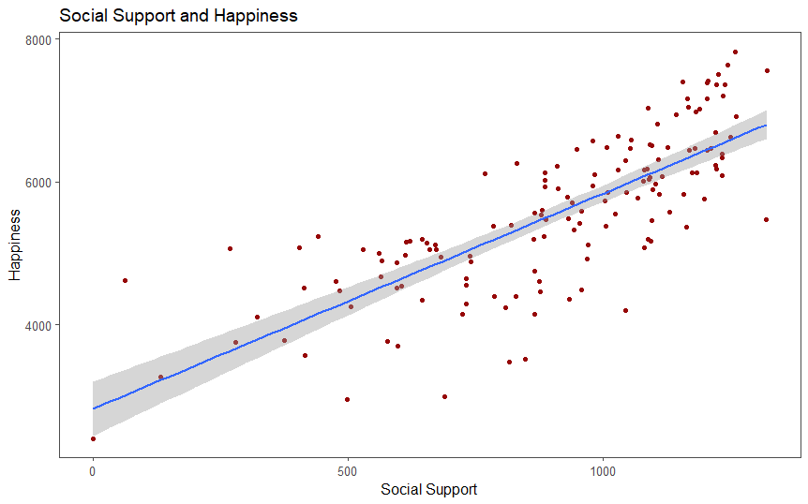
Social Support
The trend of social support with happiness is quite similar to the health trend
They show a positive significant relationship with correlation coefficient = 0.77

Slide 9
Regression Model
Based on the previous graphs and correlation coefficients, we perform regression of the happiness index with the following variables:
GDP, Healthy lifestyle, Social support, and Freedom to make life choices
Regression Results and Equation:
Happiness = 1740.7753 + 0.5295(GDP) + 1.3759(Social support) + 1.3676(Healthy) + 1.9676(Freedom)
Highest impact on happiness is put in by freedom to make life choices.
A healthy lifestyle and social support have somewhat equal implications
Intercept | GDP | Social Support | Freedom | Healthy
1740.7753 | 0.5295 | 1.3759 | 1.9679 | 1.3676

Slide 10
CONCLUSION AND POLICY RECOMMENDATIONS
We found out through analysis that important variables in determining the happiness of an individual are as follows: GDP, Healthy lifestyle, Social support, and Freedom to make life choices
Based on the concluded results we have some policy recommendations to improve happiness in a country:
Eradicating all kinds of inequalities amongst groups so that people can interact more freely and can seek social support whenever and wherever needed. It would help improve knowledge spillovers as well.
Educational institutions should teach life skills that teach individuals to tackle difficult situations in turn fostering happiness. This would help improve the emotional health of the country.
People should be able to do what they want; not what society plans for them to do. The culture of doing everything at a specific time and ‘being better than the rest’ should be put to rest.

